Slide 1

STEC Southeast Brownsville Load Project (25RPG039)
Project Overview for ERCOT RPG
January 16, 2026

Slide 2
Project Overview
The proposed project aims to support a new 250 MW load connecting to STEC’s proposed 138 kV Boca Chica* substation in Cameron County
The interconnection study for the proposed 250 MW load has identified transmission system reliability criteria violations per Section 4 of the ERCOT Planning Guide (EPG).
STEC evaluated four (4) transmission system improvement options to address reliability issues observed in the load interconnection study.
Based on the analysis performed, STEC identified Option 2 (description on next slide) as the preferred option
Tier 2 project estimated to cost $96.35 million with an in-service date of June, 2028 and will require a Certificate of Convenience and Necessity (CCN)
*Boca Chica 138kV substation connects to STEC’s new Portsouth 138 kV switching station, created by hairpinning the existing Hwy 511 – South Carbide (Chalybe) line.

Slide 3
Project Overview
Option 2, the preferred option, is comprised of the following transmission system improvements
Construct a new 138 kV Portsouth switching station with six 138kV terminal positions
Hairpin the 138kV Hwy511 to Chalybe line into the new 138kV Portsouth switching station
Hairpin the 138 kV Waterport to Southmost line into the new 138kV Portsouth switching station
Construct a new 138kV Boca Chica station with six 138kV terminals
Construct a new 19-mile 138 kV double circuit line with 2000 ampere rating (485 MVA) connecting the 138kV Portsouth switching station to the 138kV Boca Chica load serving station
Rebuild the 138kV Chalybe – Portsouth – Hwy511 line section with a minimum 2000 Ampere rating (485 MVA)

Slide 4
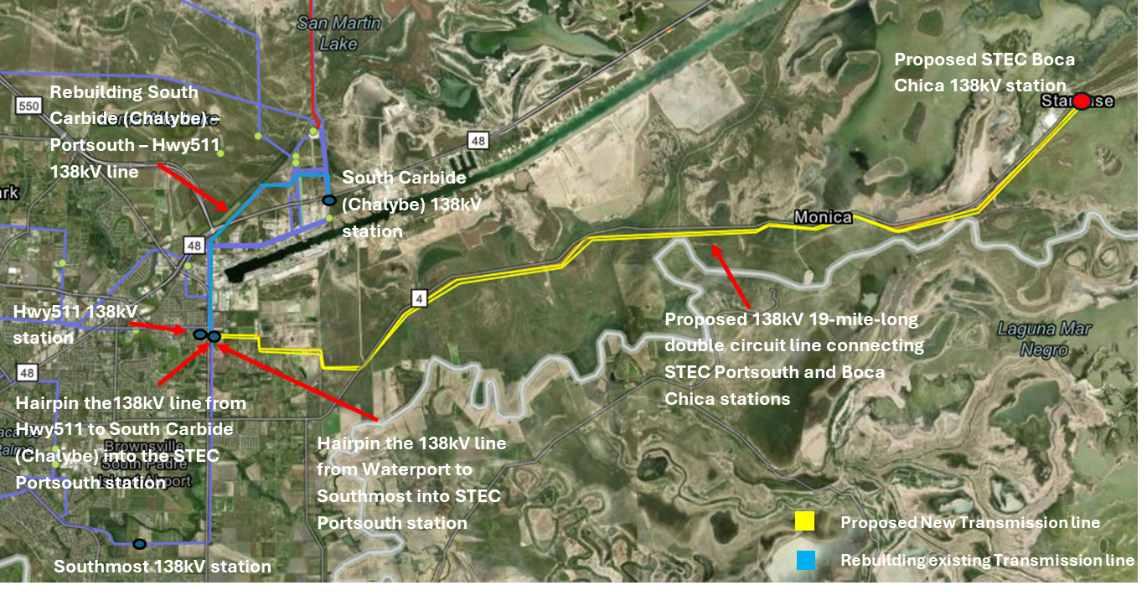
Project Overview

Slide 5
Project Need
Address the violations under NERC TPL-001-5 and EPG criteria contingencies and ensure reliable integration of the proposed 250 MW Load
Violations observed in the initial steady state assessment include
P1, P3 (EPG section 4.1.1.2(c)) contingency event violations observed in summer peak (SP) conditions
P1, P3 (EPG section 4.1.1.2(c)), P6 and EPG section 4.1.1.8 contingency event violations observed in Minimum Load (MIN) (off-peak) conditions
Based on the results of STEC’s assessment, the facility loading violations and/or low voltage issues on the following transmission system facilities are observed following addition of proposed load:
138 kV Rio Hondo to East Rio Hondo line
138 kV Central Avenue - Coffee Port - Hwy511 – South Carbide (Chalybe) line section
138kV La Palma - Los Fresnos – Stillman line section
138kV La Palma - LaurelesSub8 - Marconi - Port Isabel – Chalybe line section
138kV La Palma- Villa Cavazos - Military Highway line section
138kV Military Highway – OceloTap - Olmito -PaloAlto -Titan – South Carbide (Chalybe) line section
Additional VAR support for low voltage issues

Slide 6
Study Methodology Overview
ERCOT 2024 Steady State Working Group (SSWG) 2031SP and 2028MIN cases are utilized for assessment
Incremental topology changes are incorporated to derive the study cases for the assessment:
All off-cycle IDEVs that have been posted to the ERCOT MIS after the release date of the starting cases were applied.
Applied the October 2024 Transmission Planning and Information Tracking (TPIT) for transmission upgrades in the study area.
Any resources in the study area that met Section 6.9(1) requirements of the ERCOT Planning Guide not already modeled in the cases.
Large loads in the vicinity were modeled to develop the cases prior to adding the proposed load, per ERCOT LLI team’s input - ~1166 MW of large load additions were included based on input from ERCOT LLI Team.
Reliability assessment was performed for the cases outlined above under the following conditions:​
P0 (normal operating conditions)
P1, P2.1 and P7 contingency conditions
G-1 + N-1 (including P7) contingency conditions
X-1 + N-1 (including P7) conditions around the loss of relevant 345/138kV auto transformers in the study area.
Select set of N-1-1 (P1+P1) for Summer Peak and N-1-1 (including P1+P1, P1+P7 and P7+P7) contingency conditions for MIN condition.

Slide 7
Study Results Summary
Summary of EPG/NERC reliability criteria violations, 250 MW Southeast Brownsville Load (Cameron County, Texas)
Contingency Category | Case | Thermal Overloads (Exhibiting loading >100% of the 2-hr Emergency rating) | Voltage Violations | Unsolved Power Flow
P1 | SP | 138 kV Hwy511 – South Carbide (Chalybe) 138 kV Central Avenue - Coffee Port - Hwy511 | Multiple | Yes
P3 (EPG section 4.1.1.2(c)) | SP | 138 kV Central Avenue - Coffee Port - Hwy511 | Multiple | Yes
P1 | MIN | 138 kV Hwy511 – South Carbide (Chalybe) 138 kV Central Avenue - Coffee Port - Hwy511 138kV Rio Hondo - East Rio Hondo line | Multiple | Yes
P6 | MIN | 138kV Military Highway – OceloTap - Olmito -PaloAlto -Titan – South Carbide (Chalybe) line section 138kV La Palma - LaurelesSub8 - Marconi - Port Isabel – Chalybe line section 138 kV Central Avenue - Coffee Port - Hwy511 | None | None
P3 (EPG section 4.1.1.2(c)) | MIN | 138 kV Central Avenue - Coffee Port - Hwy511 138kV Rio Hondo - East Rio Hondo line | Multiple | Yes
EPG section 4.1.1.8 | MIN | 138kV La Palma - Los Fresnos – Stillman line section 138kV La Palma- Villa Cavazos - Military Highway line section | None | None

Slide 8
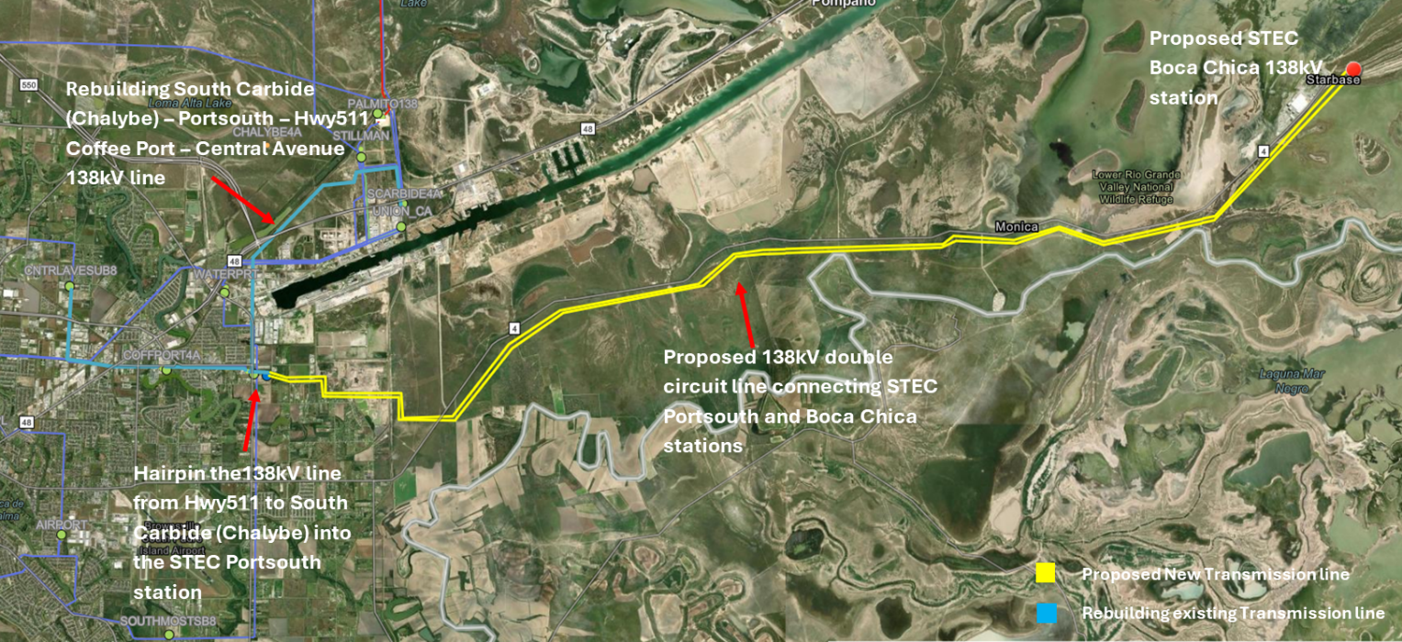
Option 1 – Portsouth 138kV source
Construct a new 138 kV Portsouth switching station with four terminals
Hairpin the Hwy511 to South Carbide (Chalybe)138 kV line into the new Portsouth switching station
Construct a new 138kV Boca Chica station with six terminals to accommodate transmission line and transformer terminals
Construct a new ~19-mile 138 kV double circuit line with 2000 ampere rating (485 MVA) connecting the Portsouth switching station to the Boca Chica station
Rebuild the South Carbide (Chalybe) – Portsouth – Hwy511 – Coffee Port – Central Avenue 138 kV line sections to a minimum 3380 Ampere rating (898 MVA).
Install a 150 MVAR reactive power support at the proposed STEC Boca Chica 138kV station.

Slide 9
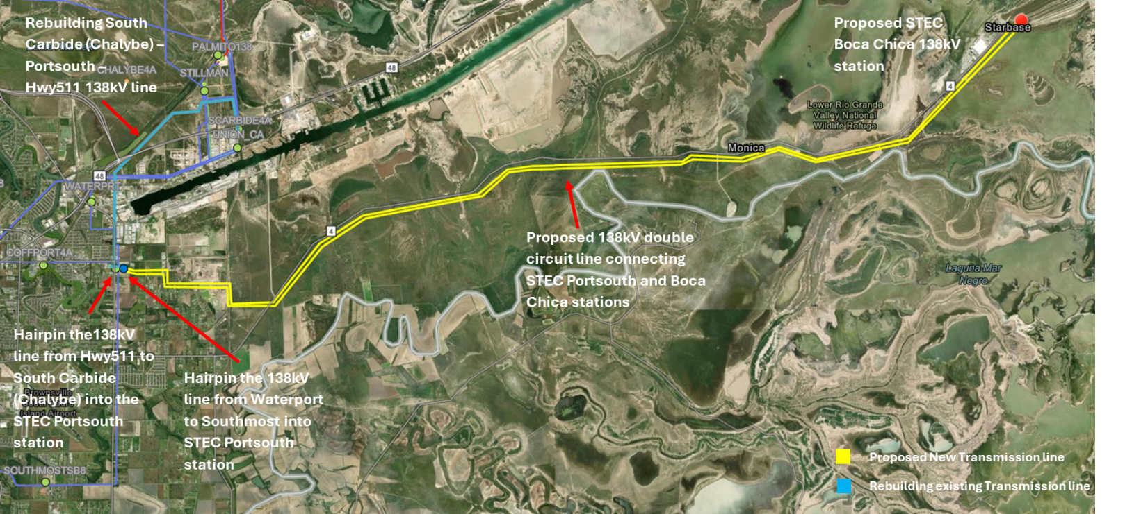
Option 2 – Hairpin of the 138kV Waterport – Southmost into Portsouth 138kV station
Construct a new 138kV Portsouth switching station with six terminals.
Hairpin the Hwy511 to South Carbide (Chalybe)138 kV line into the new Portsouth switching station.
Hairpin the 138 kV Waterport to Southmost into the new 138 kV Portsouth switching station.
Construct a new 138kV Boca Chica station with six terminals to accommodate transmission line and transformer terminals.
Construct a new ~19-mile 138 kV double circuit line with 2000 Ampere rating (485 MVA) to connect the Portsouth switching station to the Boca Chica station.
Rebuild the South Carbide (Chalybe) – Portsouth – Hwy511 138 kV line section with a minimum 2000 Ampere rating (485 MVA).
Notes:
STEC’s Preferred Option

Slide 10
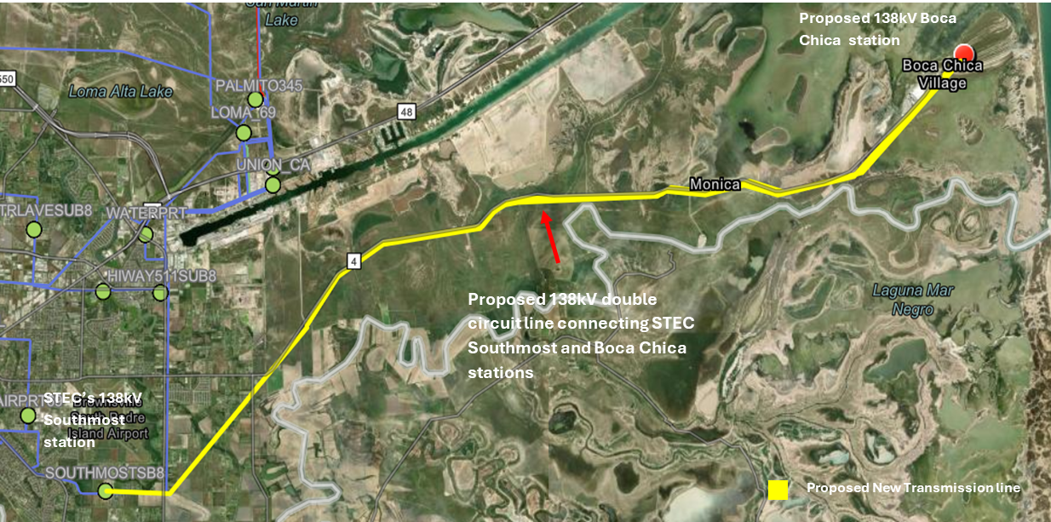
Option 3 – Southmost 138kV Source
Construct a new 138kV Boca Chica station with six terminals to accommodate transmission line and transformer terminals.
Add two new terminals at the Southmost station.
Construct a 21.85-mile 138 kV double circuit line with 2000 Ampere rating (485 MVA) to connect Southmost station to the proposed Boca Chica station.
Install 80 MVAR cap bank at the proposed STEC Boca Chica 138kV station

Slide 11
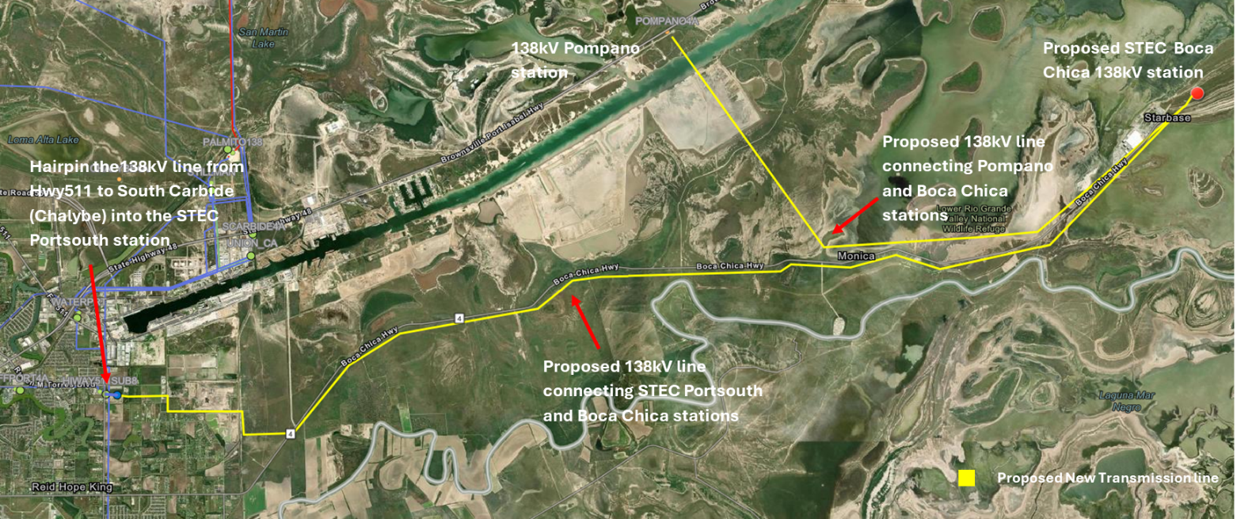
Option 4 – Portsouth & Pompano 138 kV Sources
Construct a new 138kV Portsouth switching station with four terminals.
Hairpin the Hwy511 to Carbide South (Chalybe)138 kV line into the new Portsouth switching station.
Construct a new 138kV Boca Chica station with six terminals to accommodate transmission line and transformer terminals.
Construct a new ~19-mile 138kV single circuit line with 2000 Ampere rating (485 MVA) to connect STEC’s new 138 kV Portsouth switching station to the proposed 138kV Boca Chica station.
Construct an 8-mile 138kV single circuit line with 2000 Ampere rating (485 MVA) to connect Pompano station to STEC’s 138kV Boca Chica station.
Install 150 MVAR cap bank at the STEC’s 138kV Boca Chica station.

Slide 12
Option Performance Evaluation
STEC performed steady state assessments for Options 1 through 4 to mitigate the violations observed.
A summary of performances of Options 1 through 4 is provided below
Option | Addresses all thermal overloads per EPG requirements after load | Incremental Reliability Issues Observed | Voltage Security issues | Requires CCN (~ miles) | Preferred
1 | No | Yes | No | Yes (19) | No
2 | Yes | No | No | Yes (19) | Yes
3 | No | Yes | No | Yes (21.85) | No
4 | No | Yes | No | Yes (27) | No

Slide 13
Option Performance Summary
Options 1, 3, and 4 do not resolve all EPG reliability violations observed after adding the proposed 250 MW load
Additionally, STEC observed new thermal overloads during summer peak and off-peak conditions for these options.
Option 2 adequately addresses all EPG violations for the conditions studied.
Mitigates all the thermal overloads and low voltage concerns observed under NERC and EPG criteria events for the conditions studied
No incremental issues observed
Cost-effective and reliable solution
Reliably integrates the proposed 250 MW load
Requires the least amount new greenfield transmission construction

Slide 14
Stability Assessment – Option 2
STEC utilized the ERCOT DWG 2025 flat start 2031 SP and 2028 HRML cases as the starting point of the stability analysis conducted for the study
STEC adopted assumptions consistent with the steady-state analysis to develop the stability study cases.
The impact of the proposed load and incremental implementation of Option 2 on system stability was evaluated, including:
Transient rotor angle stability
Voltage stability
The analysis focused on nearby transmission system performance under NERC and ERCOT planning guide events.
No transmission system stability concerns identified under any events studied, with proposed 250 MW load and Option 2 transmission improvements included

Slide 15
Short Circuit & SSR Assessment – Option 2
Short Circuit Assessment
STEC utilized the ERCOT System Protection Working Group (SPWG) 2030 FY case as the starting point of the short circuit analysis
STEC adopted assumptions consistent with the steady-state analysis to develop the short circuit study cases.
Fault duties were evaluated with and without the proposed load and transmission improvements comprising Option 2.
No fault duty exceedances were observed for any evaluated transmission breakers owned by STEC, BPUB, Sharyland, and AEP in the study area.
Subsynchronous Resonance (SSR) Screening Assessment
The proposed transmission improvements associated with Option 2 is not expected to have any material impact in terms of SSR risk for existing and/or planned generation resources.

Slide 16
Summary and Recommendation
Based on the study results, Option 2 addresses all reliability concerns and supports reliable integration of the proposed STEC Southeast Brownsville Load at its full capacity (250 MW)
Short circuit and stability assessments did not indicate any concerns with the addition of the proposed load and the transmission improvements associated with the preferred option (Option 2).
Option 2 is STEC’s preferred option
The preferred Option 2 will require a CCN application and is classified as a Tier 2 project
Estimated cost for Option 2 is $96.35 million and target completion date is June 2028

Slide 17
Questions?
Thank You!

